Slide 1
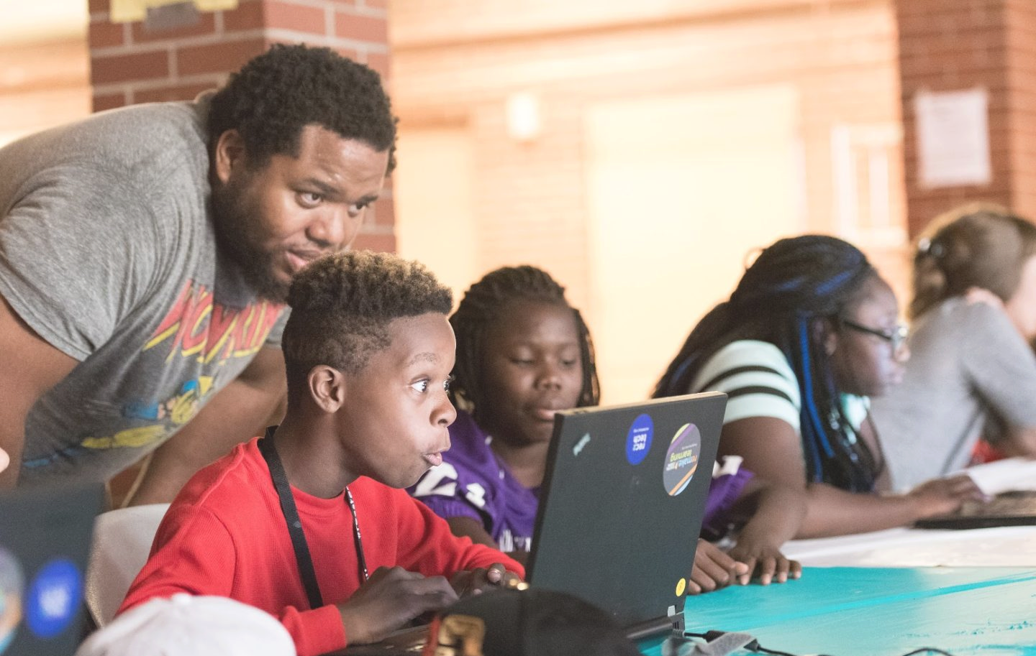
Background
Individualized tutoring is one of the most impactful academic interventions known, and yet:
Finding, retaining, paying for qualified tutors is difficult
Training tutors is more difficult
Providing tutoring to ALL students is the most difficult
Written Feedback (Generation)

Slide 2



PLUS is a comprehensive suite of solutions designed to optimize tutoring
Our mission is to double math learning for 10,000 students by 2026
What is Personalized Learning Squared (PLUS)?

Slide 3
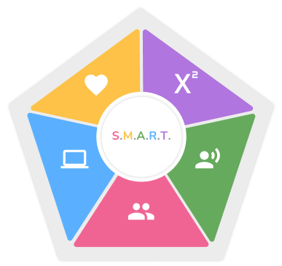
PLUS Tutor Training
SMART Competencies Framework:
Social Emotional Learning
Mastering Content
Advocacy
Relationships
Technology Tools
Both asynchronous and synchronous training options are available

Slide 4
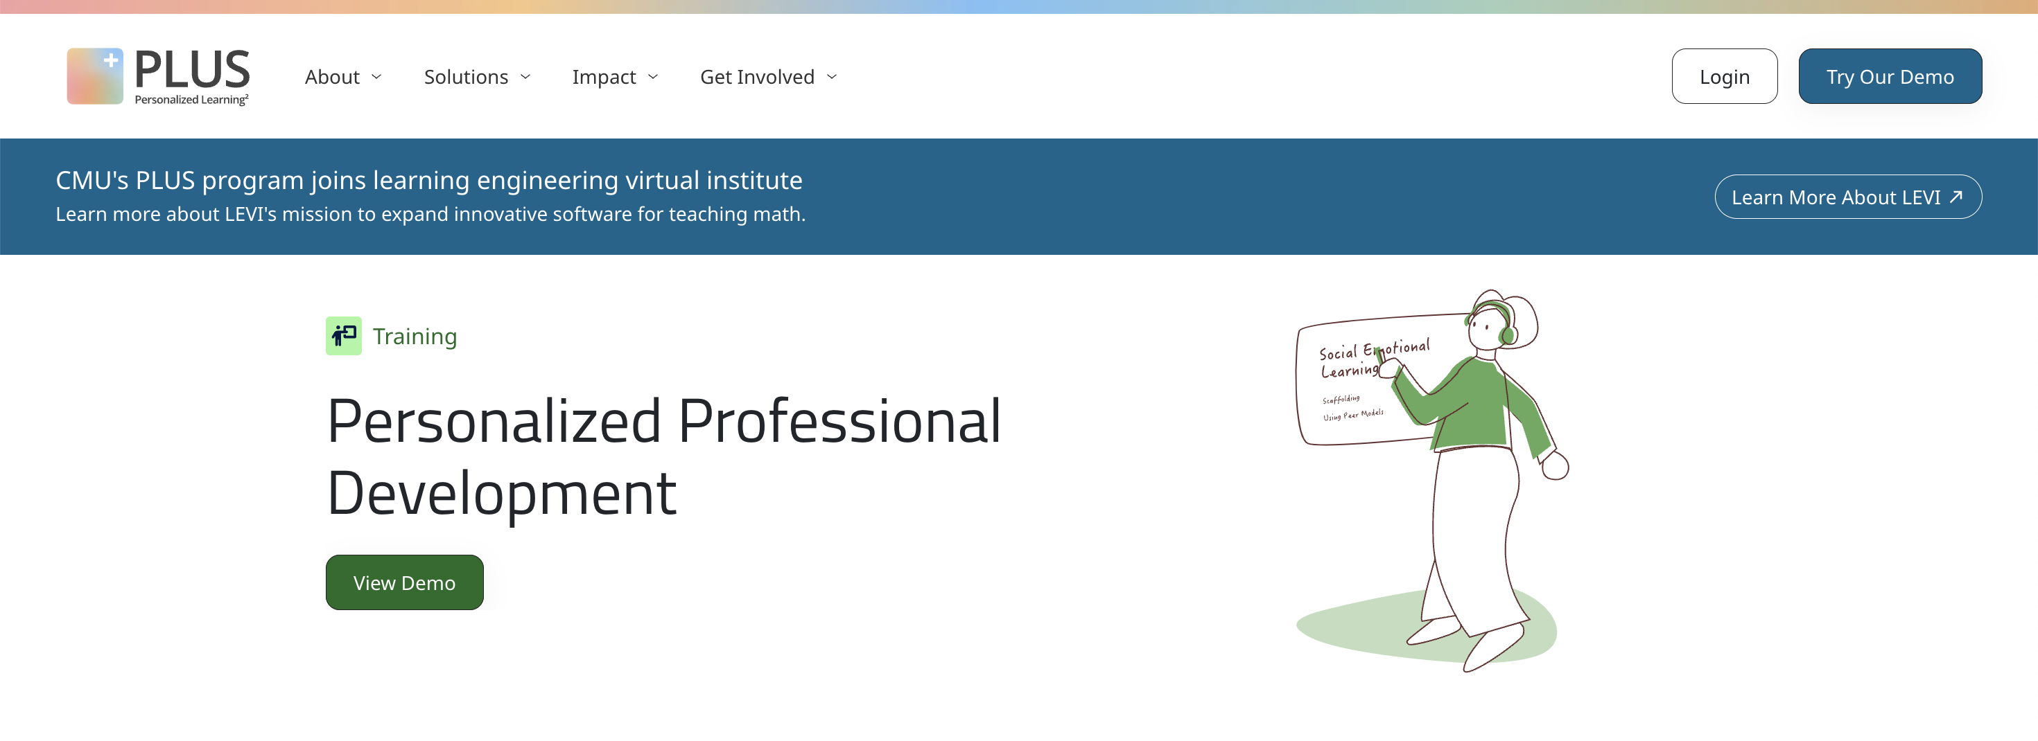
PLUS Lessons in the PLUS app
Anyone can complete our short, scenario-based lessons. Go to the PLUS site at https://tutors.plus and click on the “Login” button in the upper right corner.

Slide 5
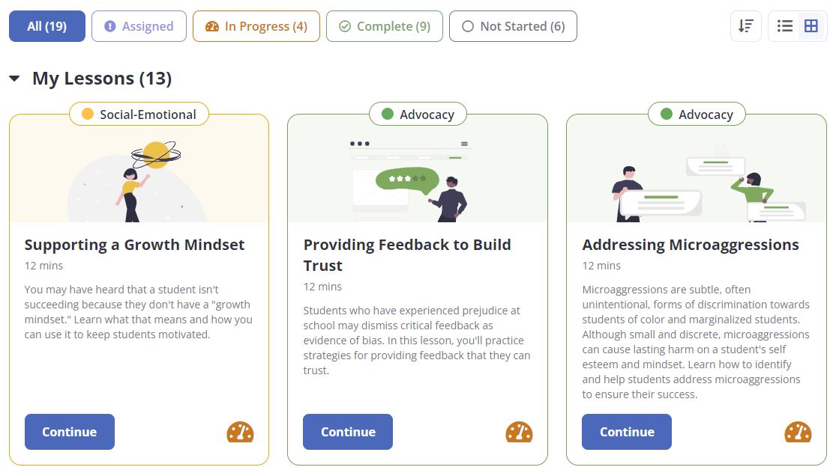
Lessons in the PLUS app

Slide 6
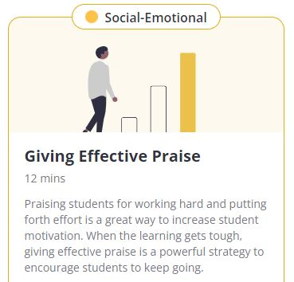
Train novice tutors (adult learners) to give effective praise for middle school students.
Effective Praise should be:
perceived as sincere, earned, and truthful.
specific by detailing what the student did well, not generic (e.g., “great job” ).
focused on the student learning process
Thomas, D., Yang, X., Gupta, S., Adeniran, A., Mclaughlin, E., & Koedinger, K. (2023, March). When the tutor becomes the student: Design and evaluation of efficient scenario-based lessons for tutors. In LAK23: 13th International Learning Analytics and Knowledge Conference (pp. 250-261).

Slide 7
Train novice tutors (adult learners) to give effective praise for middle school students.
Effective Praise should be:
perceived as sincere, earned, and truthful.
specific by detailing what the student did well, not generic (e.g., “great job” ).
focused on the student learning process
Timely
Thomas, D., Yang, X., Gupta, S., Adeniran, A., Mclaughlin, E., & Koedinger, K. (2023, March). When the tutor becomes the student: Design and evaluation of efficient scenario-based lessons for tutors. In LAK23: 13th International Learning Analytics and Knowledge Conference (pp. 250-261).

Slide 8
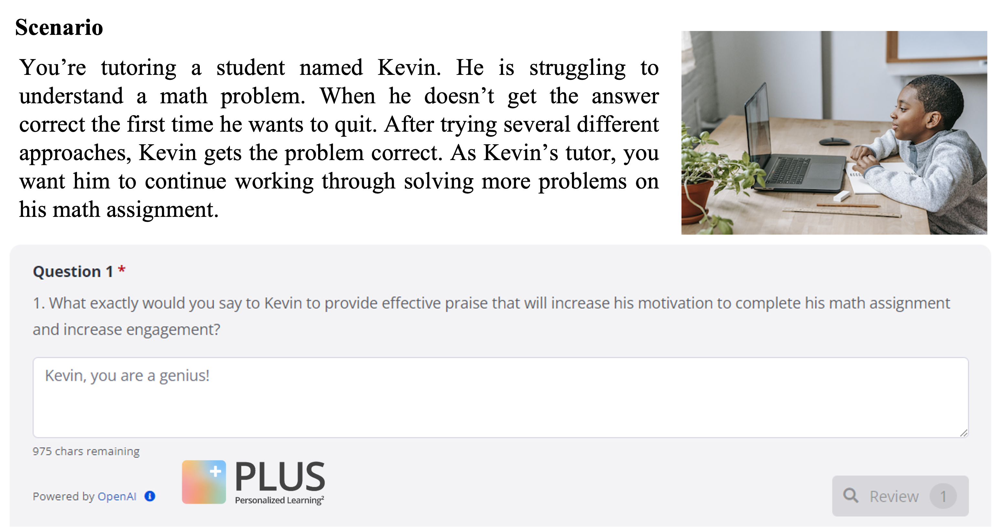
Question scenario

Slide 9
Question for learner

Slide 10
Learner’s attempt

Slide 11
129 tutor responses from the Lesson Giving Effective Praise
Examples of tutor responses:
“Well done!”

Slide 12
129 tutor responses from the Lesson Giving Effective Praise
Examples of tutor responses:
“Well done!”
“Good effort working through this.”

Slide 13
129 tutor responses from the Lesson Giving Effective Praise
Examples of tutor responses:
“Well done!”
“Good effort working through this.”
“You did it, you did well, you got the right answer and you stuck with it, I'm proud of what you have done.”

Slide 14
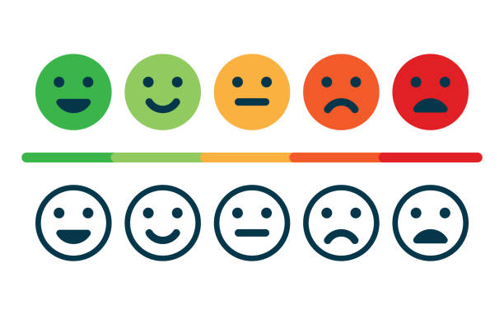
Praise types
Effort-based praise: focus on the learning process (e.g., “I like how you worked hard to…”).

Slide 15
Praise types
Effort-based praise: focus on the learning process (e.g., “I like how you worked hard to…”). Outcome-based praise: focus on student's achievements, such as getting an A on an assignment or getting a problem correct, and is often, but not always, associated with unproductive praise (e.g., “Great job!”).

Slide 16
Praise types
Effort-based praise: focus on the learning process (e.g., “I like how you worked hard to…”). Outcome-based praise: focus on student's achievements, such as getting an A on an assignment or getting a problem correct, and is often, but not always, associated with unproductive praise (e.g., “Great job!”).
Automated feedback on trainee responses to open-ended questions

Slide 17
Trainee tutor responses
(N = 129)
Founding source: Richard King Mellon Foundation, USA
Lin, J., Chen, E., Han, F., Gurung, A., Thomas, D. R., Tan, W., Ngoc, D. N., & Koedinger, K. R. (2024). How Can I Improve? Using GPT to Highlight the Desired and Undesired Parts of Open-ended Responses. 17th International Conference on Educational Data Mining (Accepted)
Aleven, V., Popescu, O., & Koedinger, K. R. (2001). Towards tutorial dialog to support self-explanation: Adding natural language understanding to a cognitive tutor. In Proceedings of Artificial Intelligence in Education (pp. 246-255).

Slide 18
Trainee tutor responses
(N = 129)
Human annotation
Founding source: Richard King Mellon Foundation, USA
Lin, J., Chen, E., Han, F., Gurung, A., Thomas, D. R., Tan, W., Ngoc, D. N., & Koedinger, K. R. (2024). How Can I Improve? Using GPT to Highlight the Desired and Undesired Parts of Open-ended Responses. 17th International Conference on Educational Data Mining (Accepted)
Aleven, V., Popescu, O., & Koedinger, K. R. (2001). Towards tutorial dialog to support self-explanation: Adding natural language understanding to a cognitive tutor. In Proceedings of Artificial Intelligence in Education (pp. 246-255).

Slide 19
Trainee tutor responses
(N = 129)
Human annotation
Prompt &
Fine-tune
GPT-3.5 & 4 models
Founding source: Richard King Mellon Foundation, USA
Lin, J., Chen, E., Han, F., Gurung, A., Thomas, D. R., Tan, W., Ngoc, D. N., & Koedinger, K. R. (2024). How Can I Improve? Using GPT to Highlight the Desired and Undesired Parts of Open-ended Responses. 17th International Conference on Educational Data Mining (Accepted)
Aleven, V., Popescu, O., & Koedinger, K. R. (2001). Towards tutorial dialog to support self-explanation: Adding natural language understanding to a cognitive tutor. In Proceedings of Artificial Intelligence in Education (pp. 246-255).

Slide 20
Trainee tutor responses
(N = 129)
Human annotation
Prompt &
Fine-tune
GPT-3.5 & 4 models
Templated explanatory feedback
Founding source: Richard King Mellon Foundation, USA
Lin, J., Chen, E., Han, F., Gurung, A., Thomas, D. R., Tan, W., Ngoc, D. N., & Koedinger, K. R. (2024). How Can I Improve? Using GPT to Highlight the Desired and Undesired Parts of Open-ended Responses. 17th International Conference on Educational Data Mining (Accepted)
Aleven, V., Popescu, O., & Koedinger, K. R. (2001). Towards tutorial dialog to support self-explanation: Adding natural language understanding to a cognitive tutor. In Proceedings of Artificial Intelligence in Education (pp. 246-255).

Slide 21
Highlights:
Developed an automated feedback, which can highlight the desired and undesired components from learners’ responses
Proposed a metric to measure the quality of highlighted components identified by GPT models
Lin, J., Chen, E., Han, F., Gurung, A., Thomas, D. R., Tan, W., Ngoc, D. N., & Koedinger, K. R. (2024). How Can I Improve? Using GPT to Highlight the Desired and Undesired Parts of Open-ended Responses. 17th International Conference on Educational Data Mining (Accepted)

Slide 22
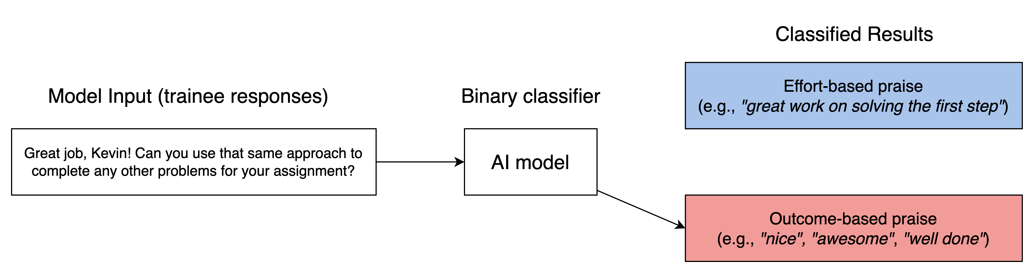

Slide 23
Feedback for trainees:
You should focus on praising the students for their effort and process towards learning. Do you want to try responding again?

Slide 24
Trainees: Where am I wrong and how can I improve?
Feedback for trainees:
You should focus on praising the students for their effort and process towards learning. Do you want to try responding again?

Slide 25
Effort-based praise Outcome-based praise
Trainee tutor: “Well done, Kevin! Let’s work on the next one”

Slide 26
Effort-based praise Outcome-based praise
Trainee tutor: “Well done, Kevin! Let’s work on the next one”
Feedback for the trainee tutor:
Saying “Well done” is praising students for the outcome. You should focus on praising the students for their effort and process towards learning. Do you want to try responding again?

Slide 27
Effort-based praise Outcome-based praise
Trainee tutor: “Good effort working through this, let’s move to the next problem.”

Slide 28
Effort-based praise Outcome-based praise
Trainee tutor: “Good effort working through this, let’s move to the next problem.”
Feedback for the trainee tutor:
Saying “Good effort working through this” is a nice example of effort-based praise, which praises students for their effort.

Slide 29
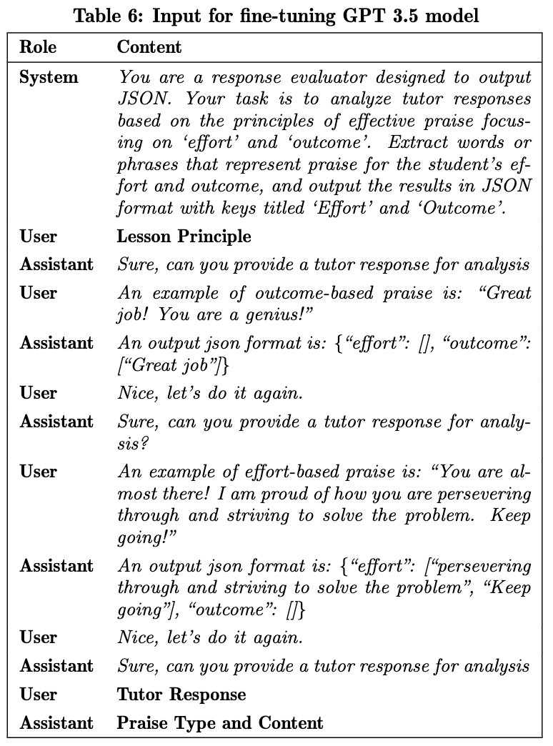
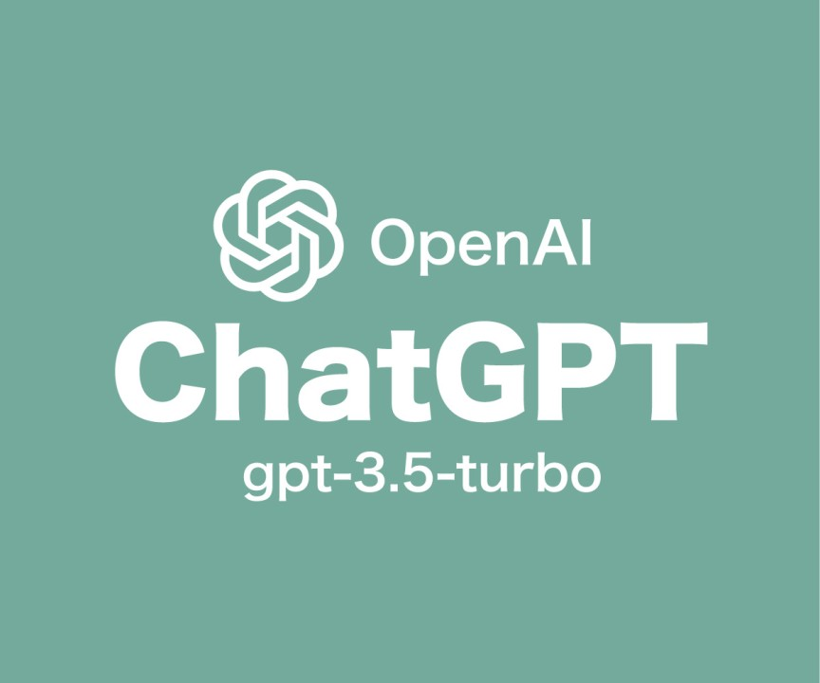
Fine-tune
65 annotated responses
Lin, J., Chen, E., Han, F., Gurung, A., Thomas, D. R., Tan, W., Ngoc, D. N., & Koedinger, K. R. (2024). How Can I Improve? Using GPT to Highlight the Desired and Undesired Parts of Open-ended Responses. 17th International Conference on Educational Data Mining (Accepted)

Slide 30
The fine-tuning method adjusts the model’s neural network by using certain amount of annotated data to better suit particular domain, thereby enhancing its performance in relevant contexts
Lin, J., Chen, E., Han, F., Gurung, A., Thomas, D. R., Tan, W., Ngoc, D. N., & Koedinger, K. R. (2024). How Can I Improve? Using GPT to Highlight the Desired and Undesired Parts of Open-ended Responses. 17th International Conference on Educational Data Mining (Accepted)

Slide 31
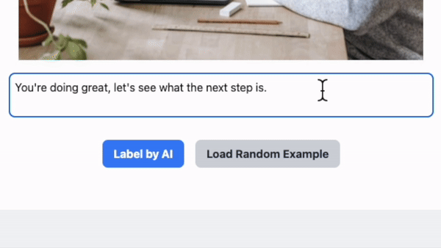
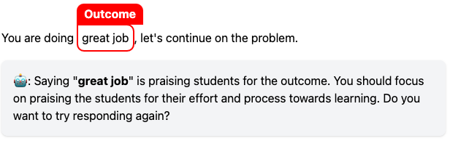
Fine-tuned GPT-3.5 for providing highlighting feedback on novice tutors’ responses
Lin, J., Chen, E., Han, F., Gurung, A., Thomas, D. R., Tan, W., Ngoc, D. N., & Koedinger, K. R. (2024). How Can I Improve? Using GPT to Highlight the Desired and Undesired Parts of Open-ended Responses. 17th International Conference on Educational Data Mining (Accepted)

Slide 32
We invite human coders to rate the accuracy of highlighted components by human expert and by GPT-3.5
Human coders rate expert’s highlight as accurate about 80% of the time and they rate GPT-3.5 as accurate about 65% of the time.
Lin, J., Chen, E., Han, F., Gurung, A., Thomas, D. R., Tan, W., Ngoc, D. N., & Koedinger, K. R. (2024). How Can I Improve? Using GPT to Highlight the Desired and Undesired Parts of Open-ended Responses. 17th International Conference on Educational Data Mining (Accepted)

Slide 33
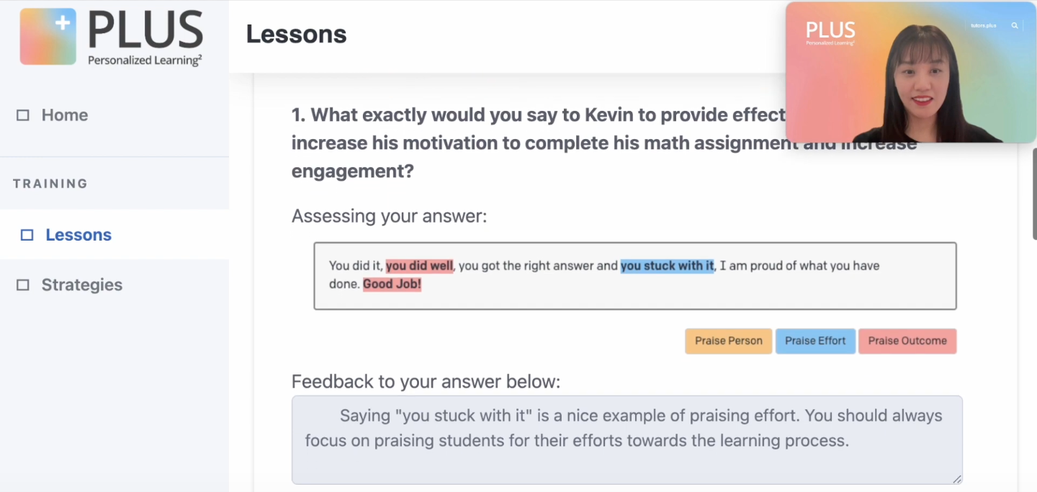
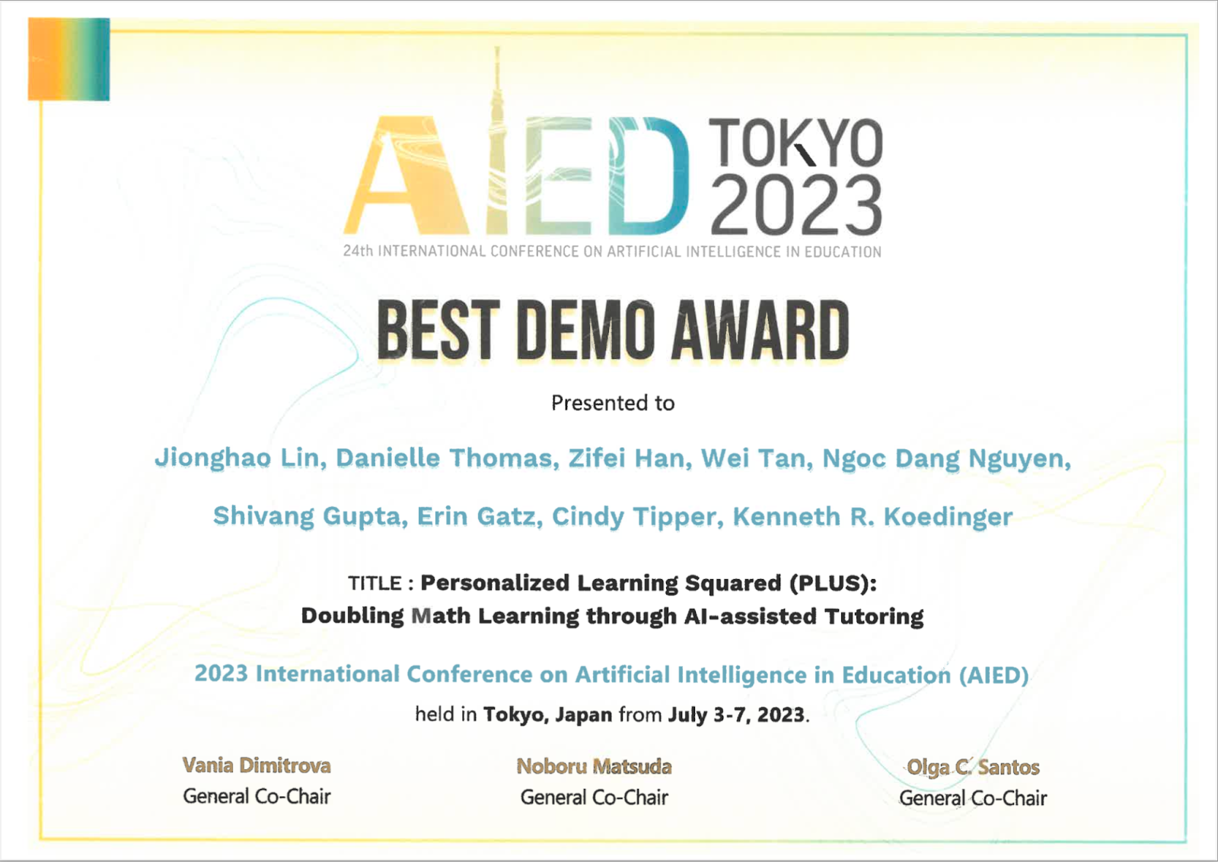
🏆 Lin, J., Thomas, D.R., Han, Z., Tan, W., Nguyen, N.D., Gupta, S., Gatz, E., Tipper, C. & Koedinger, K.R. (2023). Personalized Learning Squared (PLUS): Doubling Math Learning through AI-assisted Tutoring. AIED23 Interactive Demo - The 24th International Conference on Artificial Intelligence in Education.

Slide 34
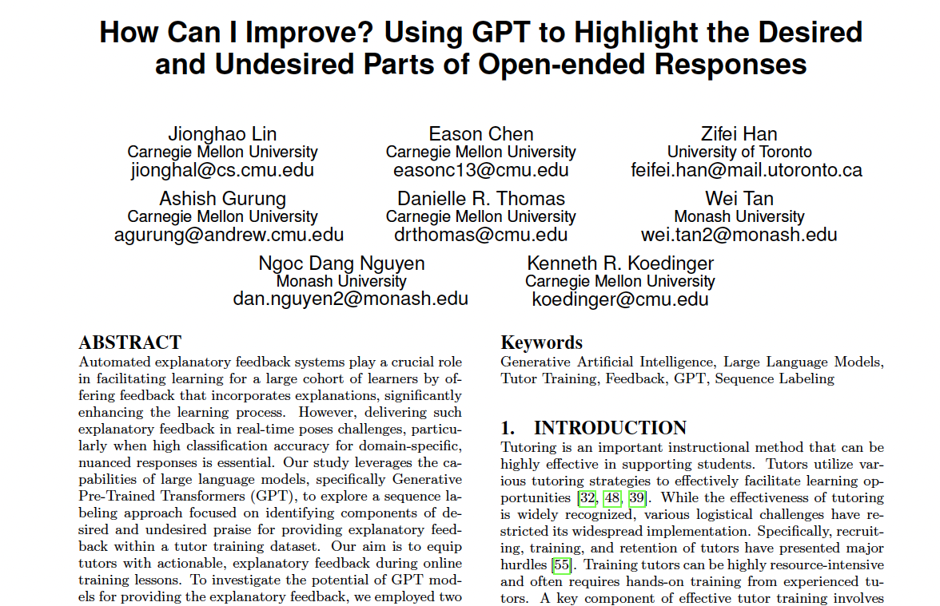
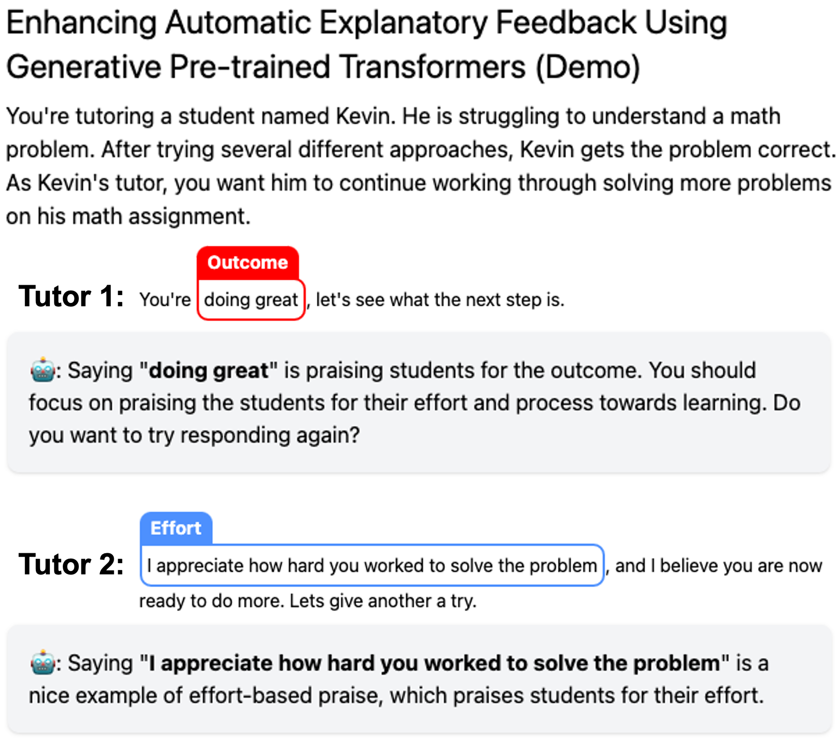
Trainees: Where am I wrong and how can I improve?
Lin, J., Chen, E., Han, F., Gurung, A., Thomas, D. R., Tan, W., Ngoc, D. N., & Koedinger, K. R. (2024). How Can I Improve? Using GPT to Highlight the Desired and Undesired Parts of Open-ended Responses. 17th International Conference on Educational Data Mining (Accepted)

Slide 35
Trainees: How Can I Get It Right?
Lin, J., Han, Z., Thomas, D. R., Gurung, A., Gupta, S., Aleven, V., & Koedinger, K. R. (2024). How Can I Get It Right? Using GPT to Rephrase Incorrect Trainee Responses. International Journal of Artificial Intelligence in Education (Accepted)

Slide 36
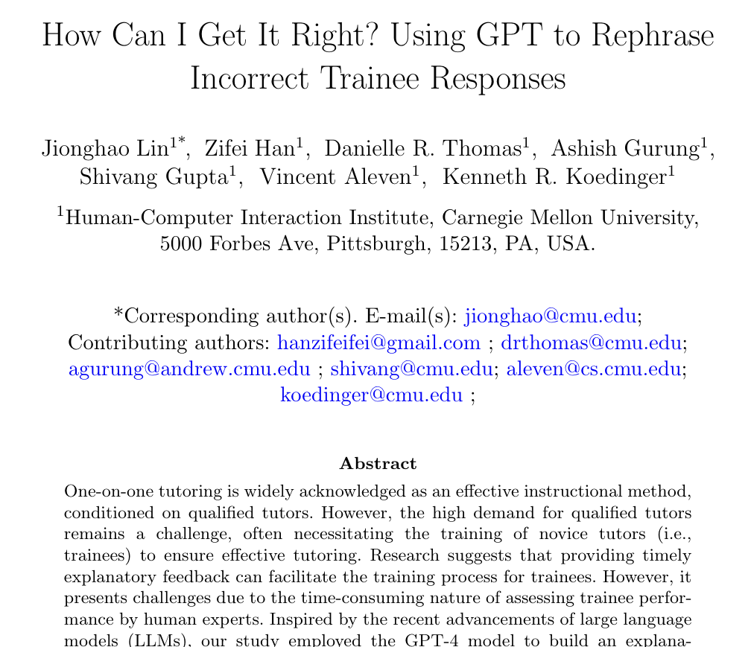
Trainees: How Can I Get It Right?
Lin, J., Han, Z., Thomas, D. R., Gurung, A., Gupta, S., Aleven, V., & Koedinger, K. R. (2024). How Can I Get It Right? Using GPT to Rephrase Incorrect Trainee Responses. International Journal of Artificial Intelligence in Education (Accepted)

Slide 37
Trainee tutor responses
(N = 129)
Human annotation
Prompt
GPT-4 models
Rephrase undesired responses into desired form
Founding source: Richard King Mellon Foundation, USA
Lin, J., Han, Z., Thomas, D. R., Gurung, A., Gupta, S., Aleven, V., & Koedinger, K. R. (2024). How Can I Get It Right? Using GPT to Rephrase Incorrect Trainee Responses. International Journal of Artificial Intelligence in Education (Accepted)
Aleven, V., Popescu, O., & Koedinger, K. R. (2001). Towards tutorial dialog to support self-explanation: Adding natural language understanding to a cognitive tutor. In Proceedings of Artificial Intelligence in Education (pp. 246-255).

Slide 38
Highlights:
Developed an automated feedback, which can predict the correctness of learners’ responses.
The incorrect responses can be further rephrased into the correct forms by GPT models
Lin, J., Han, Z., Thomas, D. R., Gurung, A., Gupta, S., Aleven, V., & Koedinger, K. R. (2024). How Can I Get It Right? Using GPT to Rephrase Incorrect Trainee Responses. International Journal of Artificial Intelligence in Education (Accepted).

Slide 39
Prompted GPT-4 for rephrasing incorrect responses into correct form
Lin, J., Han, Z., Thomas, D. R., Gurung, A., Gupta, S., Aleven, V., & Koedinger, K. R. (2024). How Can I Get It Right? Using GPT to Rephrase Incorrect Trainee Responses. International Journal of Artificial Intelligence in Education (Accepted).

Slide 40
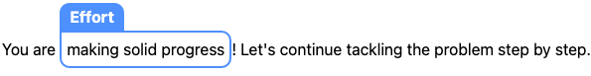
Prompted GPT-4 for rephrasing incorrect responses into correct form
AI has rephrased your response and suggests a possible improvement by recommending the following instead.
Lin, J., Han, Z., Thomas, D. R., Gurung, A., Gupta, S., Aleven, V., & Koedinger, K. R. (2024). How Can I Get It Right? Using GPT to Rephrase Incorrect Trainee Responses. International Journal of Artificial Intelligence in Education (Accepted).

Slide 41
Can GenAI accurately assess components of effective tutoring?

Slide 42

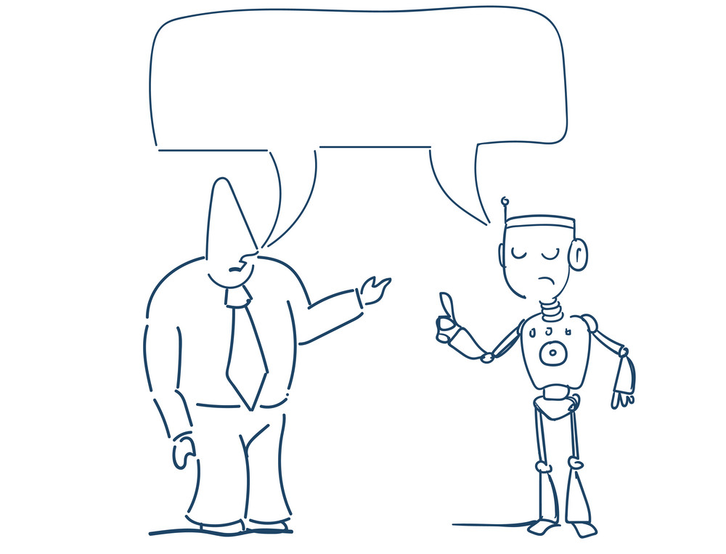
Tutoring
Dialogue Transcripts
Prompt
GPT model API
Founding: Richard King Mellon Foundation and Learning Engineering Virtual Institute

Slide 43
Tutoring
Dialogue Transcripts
Evaluation Report
There is no explicit encouragement of the learning process over simply getting the answer.
The tutor helps the student understand the math problem without directly calling out errors
……
Prompt
GPT model API
Founding: Richard King Mellon Foundation and Learning Engineering Virtual Institute

Slide 44
Highlights:
Demonstrated the potential of prompting GPT models on evaluating the tutors’ performance from real-world tutoring (Kakarla et al., 2024)
Comparative analysis of the advanced prompting strategies on evaluating the tutors’ practice from real-world tutoring (e.g., Tree of thoughts and Retrieval Augmented Generation)
Kakarla, S., Thomas, D., Lin, J., Gupta, S., & Koedinger, K. R. (2024). Using Large Language Models to Assess Tutors' Performance in Reacting to Students Making Math Errors. AAAI2024 Workshop on AI for Education - Bridging Innovation and Responsibility
Han, F. Z., Lin, J., Gurung, A., Thomas, D. R., Chen, E., Borchers, C., Gupta, S., & Koedinger, K. R. (2024). Improving Assessment of Tutoring Practices using Retrieval-Augmented Generation. AAAI2024 Workshop on AI for Education - Bridging Innovation and Responsibility

Slide 45
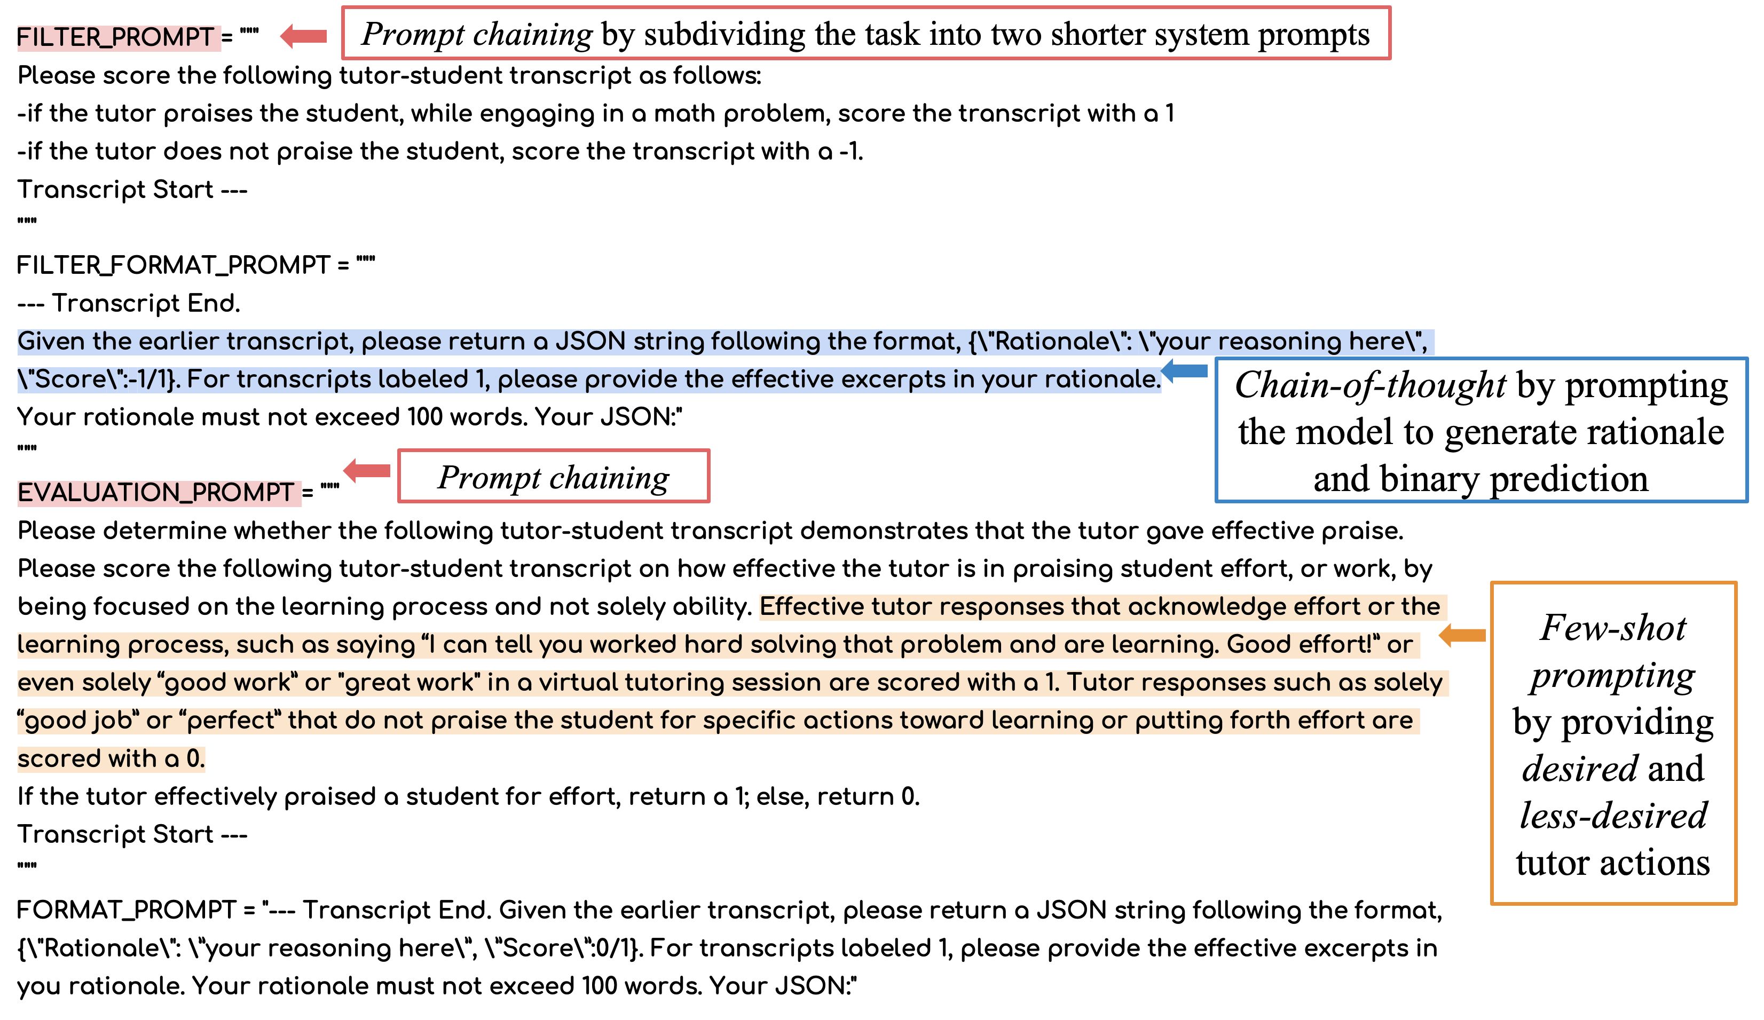
We engineered a few-shot chain-of-thought prompt strategy for evaluating the tutors’ performance on how to respond to students’ errors from real-world tutoring
Kakarla, S., Thomas, D., Lin, J., Gupta, S., & Koedinger, K. R. (2024). Using Large Language Models to Assess Tutors' Performance in Reacting to Students Making Math Errors. AAAI2024 Workshop on AI for Education - Bridging Innovation and Responsibility
Dialogue Tutoring (Understanding, GenAI)

Slide 46
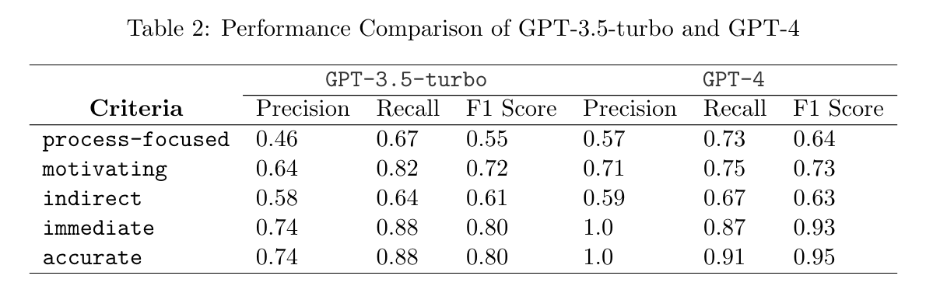
Prompting the GPT-4 model demonstrated proficiency in identifying criteria on how to best respond to students making an error.
Kakarla, S., Thomas, D., Lin, J., Gupta, S., & Koedinger, K. R. (2024). Using Large Language Models to Assess Tutors' Performance in Reacting to Students Making Math Errors. AAAI2024 Workshop on AI for Education - Bridging Innovation and Responsibility
Chine, D. R., Brentley, C., Thomas-Browne, C., Richey, J. E., Gul, A., Carvalho, P. F., ... & Koedinger, K. R. (2022, July). Educational equity through combined human-AI personalization: A propensity matching evaluation. In International Conference on Artificial Intelligence in Education (pp. 366-377). Cham: Springer International Publishing.
Dialogue Tutoring (Understanding, GenAI)

Slide 47
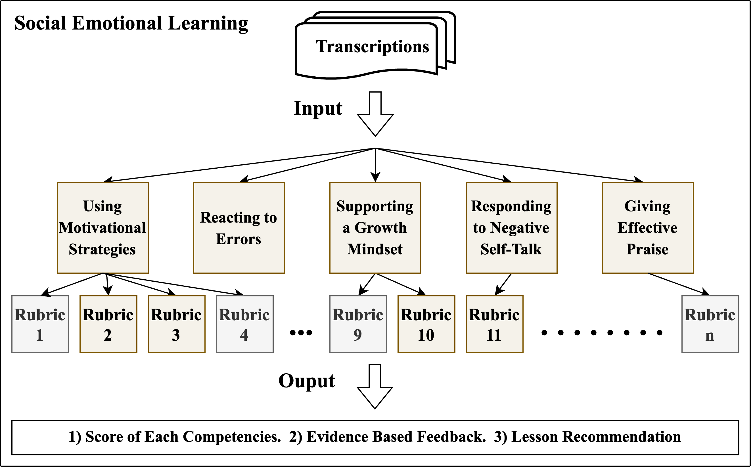
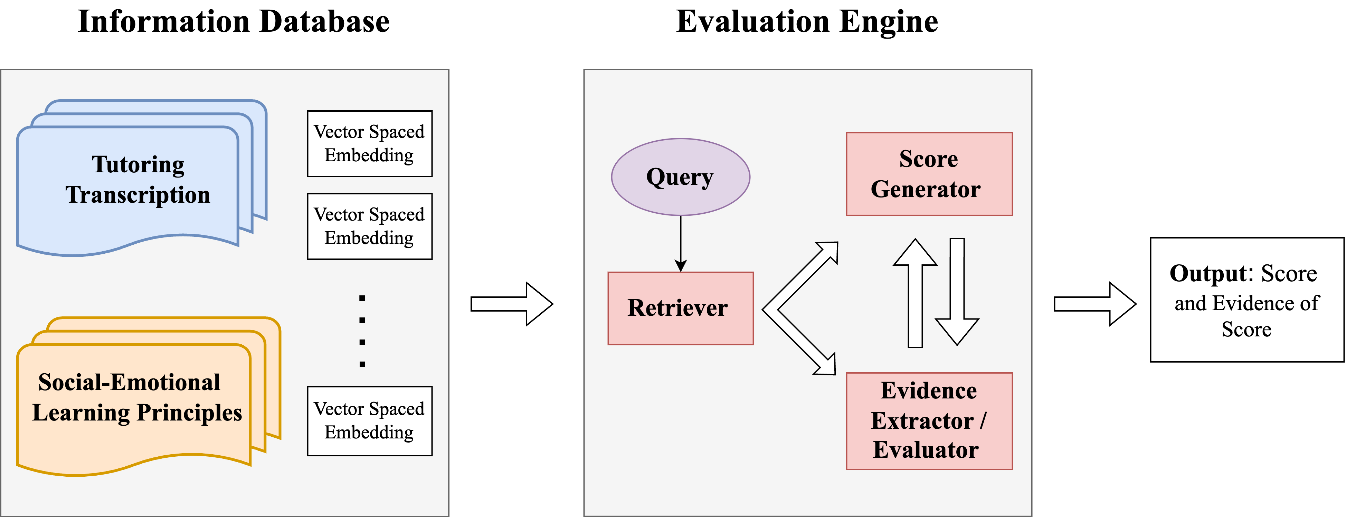
We engineered a set of prompting strategy for evaluating the tutors’ performance on showing social-emotional learning skills from real-world tutoring
Tree of Thought (ToT)
Retrieval Augmented Generation (RAG)
Han, F. Z., Lin, J., Gurung, A., Thomas, D. R., Chen, E., Borchers, C., Gupta, S., & Koedinger, K. R. (2024). Improving Assessment of Tutoring Practices using Retrieval-Augmented Generation. AAAI2024 Workshop on AI for Education - Bridging Innovation and Responsibility
Dialogue Tutoring (Understanding, GenAI)

Slide 48
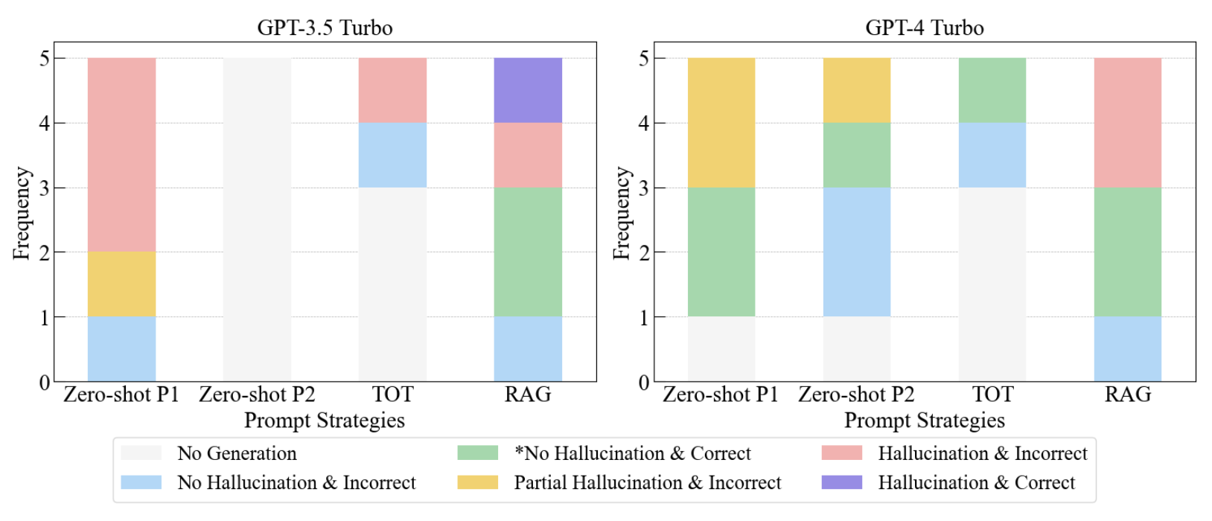
The Retrieval-Augmented Generation (RAG) approach produced the most desired output across different GPT versions (Han et al., 2024).
Han, F. Z., Lin, J., Gurung, A., Thomas, D. R., Chen, E., Borchers, C., Gupta, S., & Koedinger, K. R. (2024). Improving Assessment of Tutoring Practices using Retrieval-Augmented Generation. AAAI2024 Workshop on AI for Education - Bridging Innovation and Responsibility
Dialogue Tutoring (Generation)
Dialogue Tutoring (Understanding, GenAI)

